Slide 1
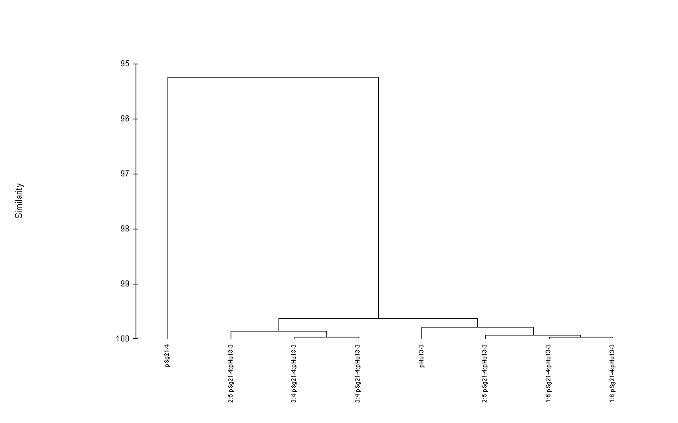
At base #84, consensus is an A (Sg21-4)
Hu13-3 has A84C
Both plasmids have the same downstream
differences from the consensus.

